Slide 1
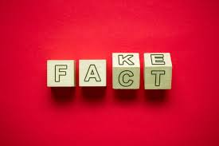
Fake News:
How and why should we talk about it in High School?

Slide 2
Fake news, what is it?
false or misleading information presented as news, often to damage reputation or make money
Fake News definition- Wikipedia

Slide 3
Fake news, what is it?
Fake news is false or misleading information presented as news.It often has the aim of damaging the reputation of a person or entity, or making money through advertising revenue.Media scholar Dr. Nolan Higdon has offered a more broad definition of fake news as “false or misleading content presented as news and communicated in formats spanning spoken, written, printed, electronic, and digital communication."
Fake News definition- Wikipedia

Slide 4
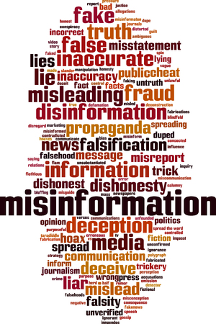
Disinformation X Misinformation
Misinformation is false or inaccurate information that is communicated regardless of an intention to deceive. For example, when we repost things without fact checking.
Disinformation is misinformation that is deliberately deceptive. For example, malicious hoaxes, computational propaganda, conspiracy theories.

Slide 5
How is Fake News spread?
satire or parody ("no intention to cause harm but has potential to fool")
false connection ("when headlines, visuals or captions don't support the content")
misleading content ("misleading use of information to frame an issue or an individual")
false context ("when genuine content is shared with false contextual information")
impostor content ("when genuine sources are impersonated" with false, made-up sources)
manipulated content ("when genuine information or imagery is manipulated to deceive", as with a "doctored" photo)
fabricated content ("new content is 100% false, designed to deceive and do harm")
Fake News Glossary

Slide 6

Example of fake news that created chaos:
Back in March 2016, ESPN's Adam Schefter appeared on NFL Live to discuss the breaking news of Olivier Vernon signing with the Jacksonville Jaguars on a four-year deal worth $75.5 million. The only problem was that the deal never actually happened.
“NFL Live ran with the report and Schefter started analyzing the fake deal. Vernon went on to sign an $85 million deal with the New York Giants. Schefter apologized on the air shortly after the segment ran.”
ESPN wastes 1 hour commenting on fake news

Slide 7
Data and Our part in it:
Research has found that false political information tends to spread "3 times" faster than other false news.
False news have 70% higher chance of being retweeted than truthful news.
More so, it is humans who are responsible in disseminating false news and information as opposed to bots and click-farms.
There are enormous potential ramifications to these results. False news can drive the misallocation of resources during terror attacks and natural disasters, the misalignment of business investments, and can misinform elections.
article source

Slide 8
Data and our part in it:
The tendency for humans to spread false information has to do with human behavior; according to research, humans are attracted to events and information that are surprising and new, and, as a result, causes high-arousal in the brain.
article source

Slide 9
Calls for action
In an effort to reduce the effects of fake news, fact-checking websites, including Snopes.com and FactCheck.org, have posted guides to spotting and avoiding fake news websites.
Social media sites and search engines, such as Facebook and Google, received criticism for facilitating the spread of fake news. Both of these corporations have taken measures to explicitly prevent the spread of fake news; critics, however, believe more action is needed.

Slide 10
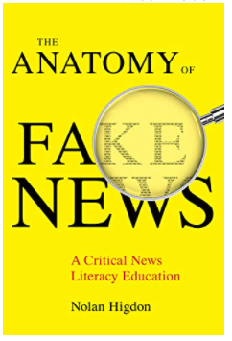
Book Club
Media scholar Nolan Higdon has offered a more broad definition of fake news as “false or misleading content presented as news and communicated in formats spanning spoken, written, printed, electronic, and digital communication." He argues that relying on tech-companies to solve the issues with false information will exacerbate the problems associated with fake news, because tech-companies lack an incentive for solving the problem because they benefit from the proliferation of fake news. Higdon cites tech-companies utilization of data collection as one of the strongest forces empowering fake news producers.

Slide 11

Calls for action in Education
Rather than government regulation or industry censorship, Higdon argues for the introduction of critical news literacy education to American education.
The News Literacy Project offers several resources and services for educators, including an online learning platform, a free weekly newsletter, professional development opportunities, a variety of classroom materials and more.
https://newslit.org/educators/

Slide 12
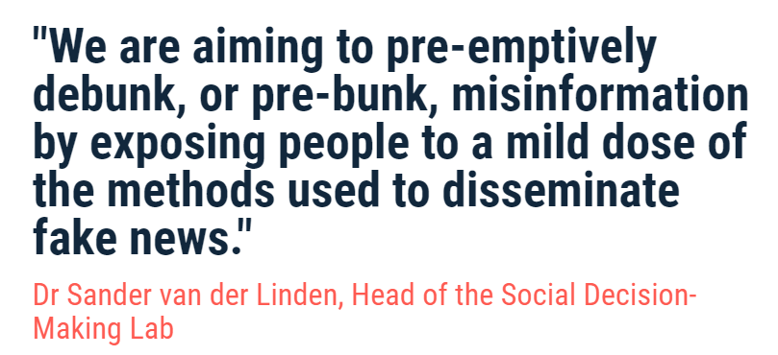
Cambridge game 'pre-bunks' Covid19 fake news
Go Viral game

Slide 13
Bad News - Interactive Game
Bad news game information
Bad News game - Play it!

Slide 14
Coding activities for students:
For Advanced Students
Using Python to Detect Fake News
For Intermediate
Students Worksheet
Example Program Solution

Slide 15
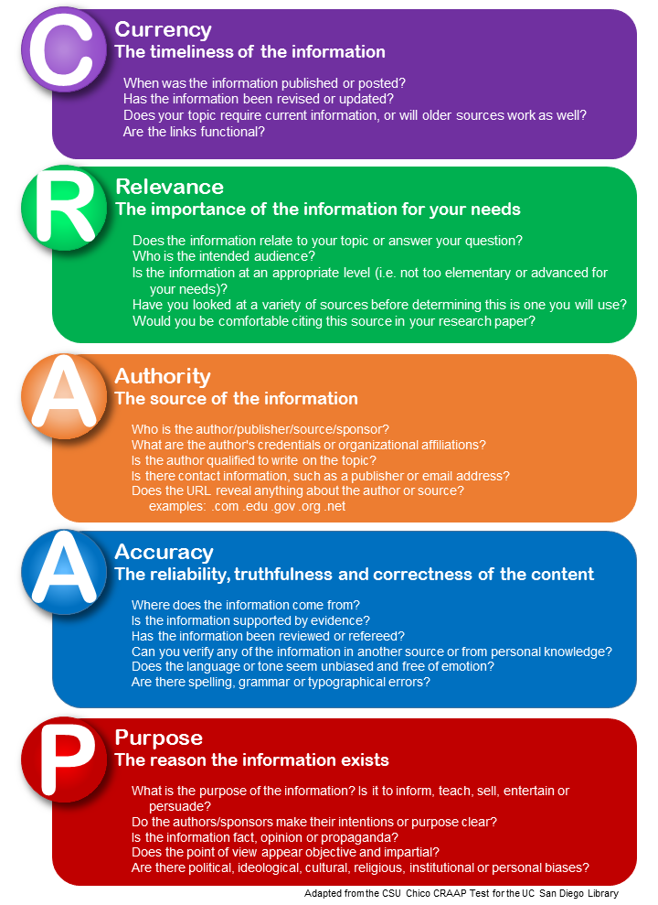
Protocols for students:
Video Explaining Protocol
Protocol Handout of Guiding Quesitons

Slide 16
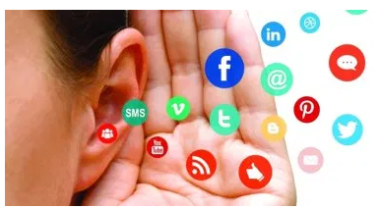
Fake news or not? This is the best course EVER!

